Slide 1
Hydrographic Streamline Detection Using LiDAR and Deep Learning
Zewei Xu^{1,3}, Nattapon Jaroenchai^{1,3}, Zhe Jiang^{2,4}, Larry Stanislawski⁵, Ethan J Shavers⁵, Shaowen Wang^{1,3}
Department of Geography & Geographic Information Science¹
Department of Computer Science²
University of Illinois at Urbana-Champaign³
University of Alabama⁴
US Geological Survey⁵
CEGIS Annual Meeting
Rolla, Missouri
08/28/2019

Slide 2
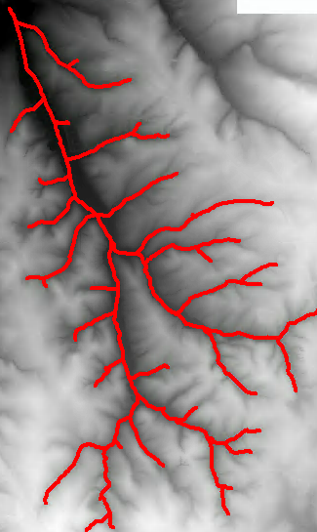
Background
scientific disciplines
river
agriculture suitability
creeks
Water resource assessment
Ponds
River dynamics
Wetlands
Flood mapping
……
Streamline mapping
Image courtesy of Google
2
Notes:
Fresh water is one of the irreplaceable strategic resources for human survival and social development
Reliable information about the spatial distribution of open surface water is critically important in various scientific disciplines, such as the assessment of present and future water resources, climate models, agriculture suitability, river dynamics, wetland inventory, watershed analysis, surface water survey and management, flood mapping, and environment monitoring

Slide 3
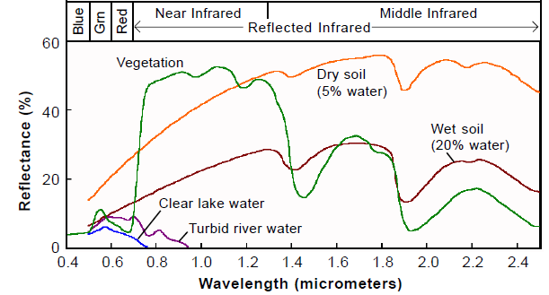
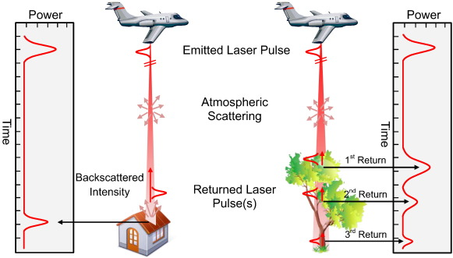
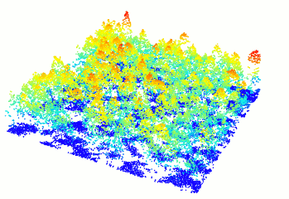
Why LiDAR?
LiDAR uses NIR light in the form of laser pulses to measure reflectance distances to objects
Laser pulses of LiDAR can penetrate many obstacles and provide multiple returns, which can generate precise, three-dimensional information of land surface characteristics
Image courtesy : https://www.researchgate.net/figure/Typical-spectral-signature-of-different-surfaces-wwwmicroimagescom_fig6_283355006
Example of LiDAR point cloud
Image courtesy : https://raw.githubusercontent.com/Jean-Romain/storage/master/README/point-cloud-rotating.gif
Image courtesy : https://www.pnas.org/content/pnas/116/4/1074/F2.large.jpg
3
Notes:
LiDAR uses NIR light in the form of a pulsed laser to measure ranges (variable distances) to the ground. These light pulses—combined with other data recorded by the airborne system— generate precise, three-dimensional information about the shape of the Earth and its surface characteristics.

Slide 4
Traditional Methods
Flow accumulation techniques are often used to derive stream networks from Digital Elevation Models (DEMs)
National Hydrography Dataset
Problems
Flow accumulation methods require appropriate thresholds to extract an accurate density of drainage lines
Elevation-derived drainage lines must be validated or edited using high-resolution image data or field data
At intersections between roads (or bridges) and valleys, flow accumulation could be obstructed by the higher elevation of roads, producing inaccurate extraction of drainage lines
Image courtesy of USGS
4

Slide 5
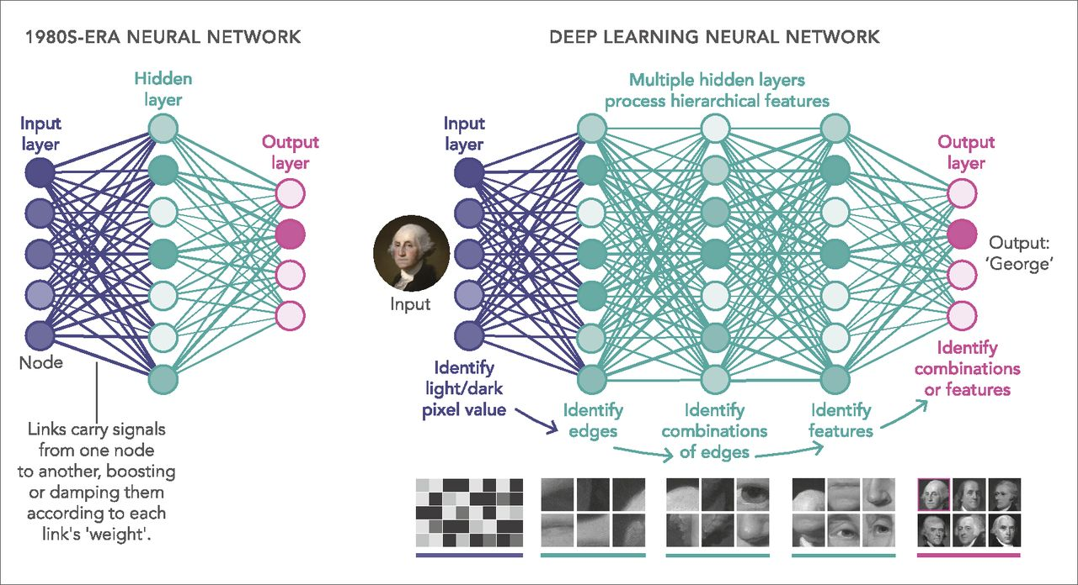
Deep learning
Deep learning is a type of machine learning algorithms that uses multiple layers (normally more than two hidden layers) to progressively extract and learn representations of data with multiple levels of abstraction (LeCun et al., 2015).
Image courtesy: https://www.pnas.org/content/pnas/116/4/1074/F2.large.jpg
6
Image courtesy of Google

Slide 6
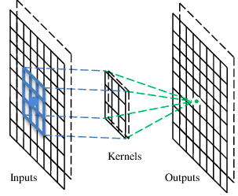
Convolutional Neural Network
A convolutional neural network (CNN) is a type of deep learning networks that uses convolutional layers (and some other layers) to achieve an efficient and accurate feature extraction for classification or segmentation problems using a local connectivity and weights sharing architecture.
Feature detector
A filter
Example of Convolutional layer
Example of Convolutional Network
Image courtesy of Google
6

Slide 7
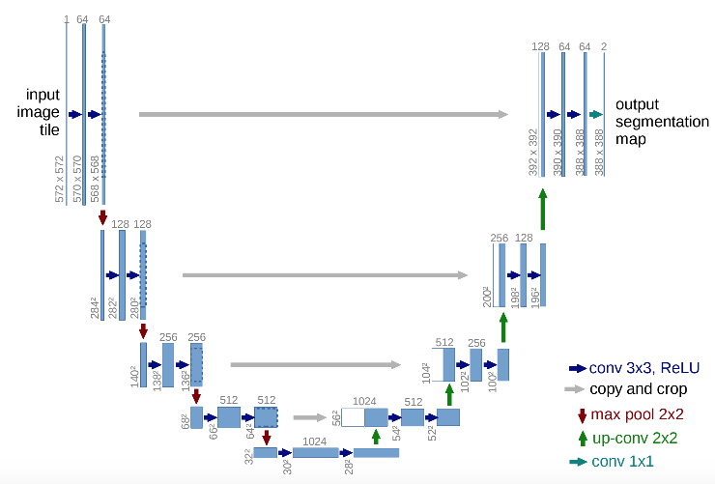
U-net Model
A state-of-the-art fully convolutional neural network that produces high accuracies over semantic segmentation problems
It uses down-sampling path for feature extraction followed by up-sampling path for precise localization of these features in higher resolution layers
It concatenates global feature maps with local ones to help achieve high accuracy in segmentation results
Contractive path
Expanding path
Image courtesy of Ronneberger, O. et al., 2015
7

Slide 8
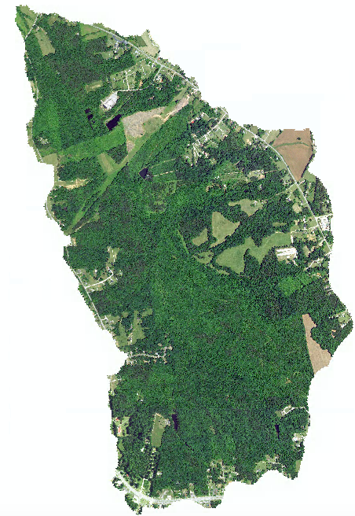
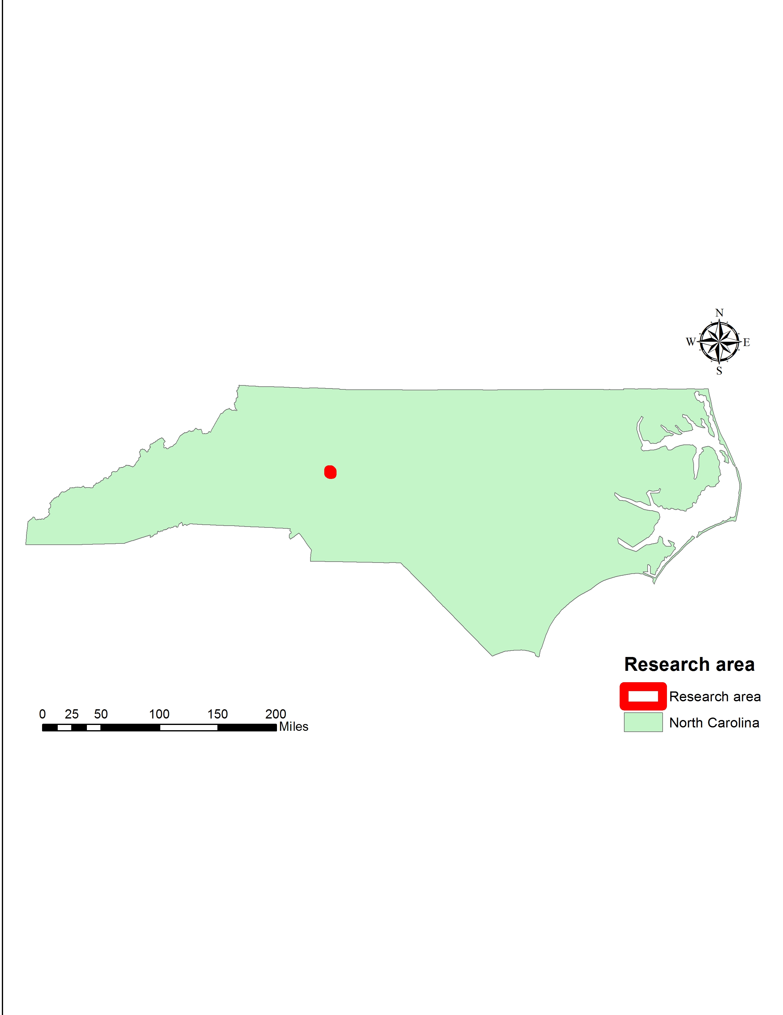
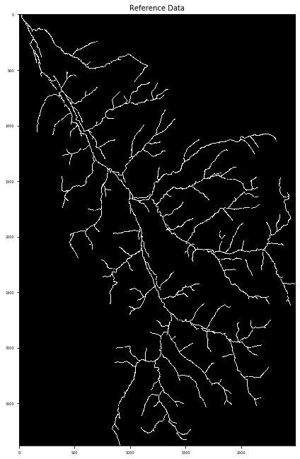
Study Area and Reference Data
Rowan county watershed, NC
Area of ~18.11km²
Land cover is mostly composed of forest, wetlands, and agricultural land
Elevation variation: 222m
Reference data
Geonet lines
Resolution: 1 meter
8
Notes:
LiDAR uses NIR light in the form of a pulsed laser to measure ranges (variable distances) to the ground. These light pulses—combined with other data recorded by the airborne system— generate precise, three-dimensional information about the shape of the Earth and its surface characteristics. Especially, these

Slide 9
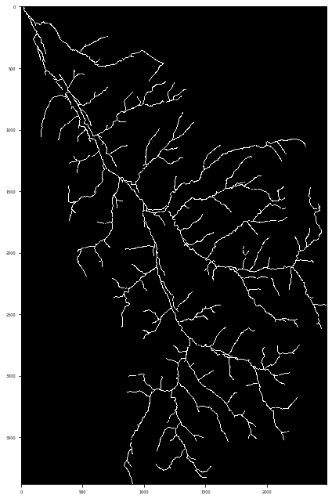



Data preparation
Training and Validation data
Samples are randomly selected from the upper half of the study area
Training: 900 sample patches/per class
Validation: 300 sample patches/per class
*patch size = 224 pixels *224 pixels
Stream class patches
Non-stream class patch

Slide 10


Testing Data
Testing samples are generated from the lower half of the study area
To eliminate the edge effect, samples are generated using a moving window (30 pixels) strategy
*patch size = 224 pixel *224 pixel
Testing patches

Slide 11
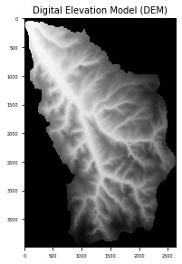
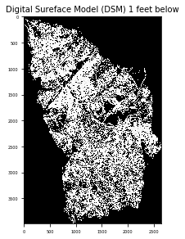
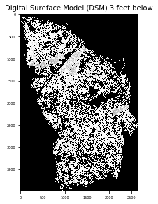
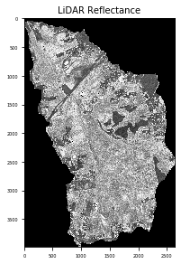
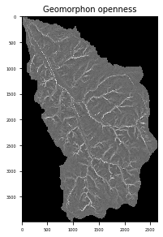
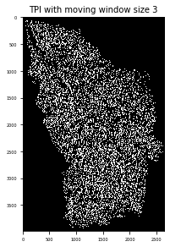
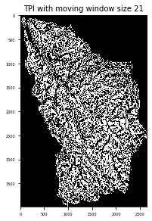
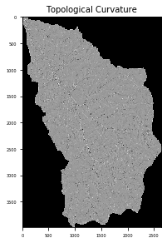
LiDAR-based Feature Maps
LiDAR derived feature maps
Elevation feature maps
11
Notes:
LiDAR uses NIR light in the form of a pulsed laser to measure ranges (variable distances) to the ground. These light pulses—combined with other data recorded by the airborne system— generate precise, three-dimensional information about the shape of the Earth and its surface characteristics. Especially, these

Slide 12
Model training
GPU
Tesla K80, with 16GB of GDDR5 memory
Parameters
Max epoch: 200 / Learning rate: 0.0001 / Patience: 20 / Decaying factor: 0.7 / Batch size: 32
Time Complexity of model training
Each epoch takes 1.5 minutes
Total training time is about 100 minutes
Model prediction time is negligible

Slide 13
Results

Slide 14
Results
Statistics of the entire area
 | Stream | Non-Stream
F1 score | 79.44% | 98.97%
Precision | 73.68% | 99.36%
Recall | 86.18% | 98.58%
Statistics of the testing area
 | Stream | Non-Stream
F1 score | 71.23% | 98.65%
Precision | 68.04% | 98.87%
Recall | 74.73% | 9844%

Slide 15
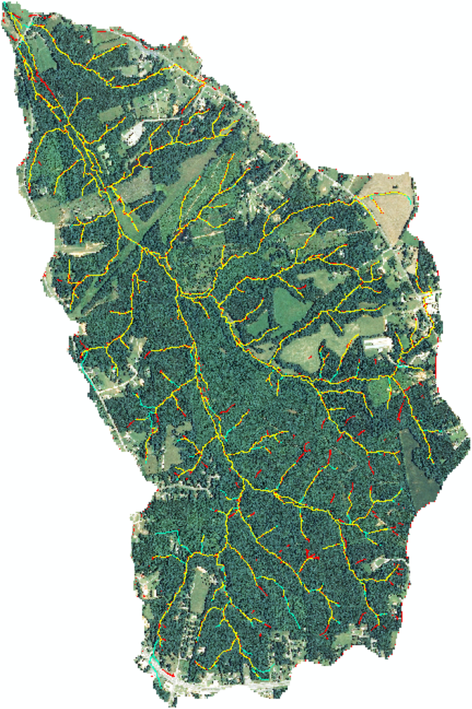
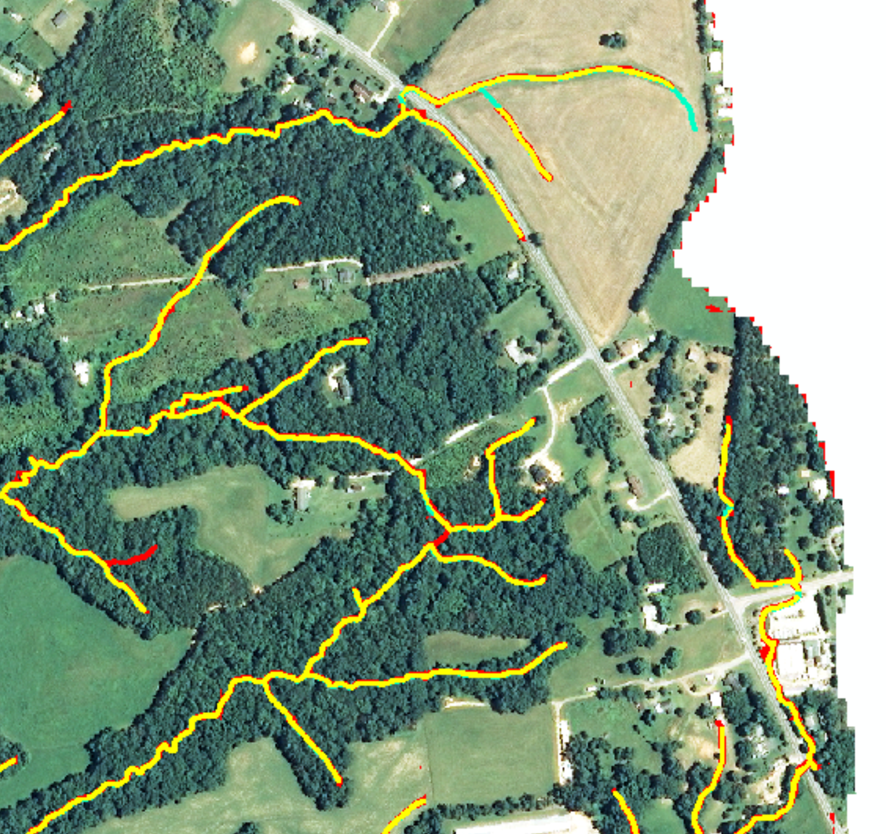
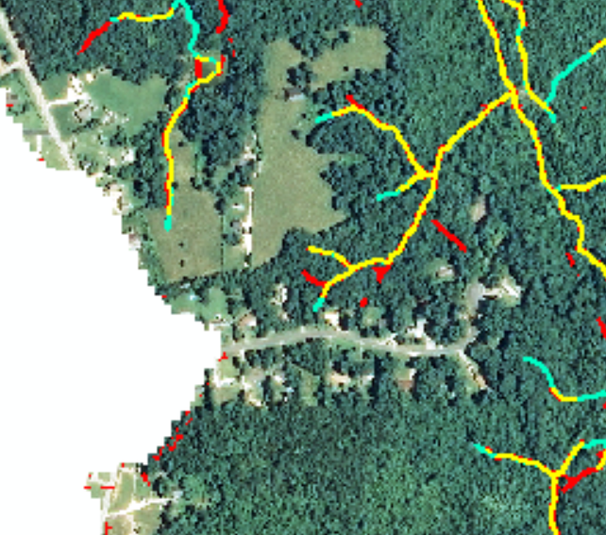
Visualization
Correct Prediction
Omission errors
Commission errors

Slide 16
Discussion
The U-net model can generate high accuracy streamlines by learning from the feature maps derived from LiDAR
The proposed model can partly solve the intersection issue caused by the road or bridge intersections on streamlines
Global connectivity of streamlines
Concatenation of global features with local features from the contractive path to the expanding path
The dominant error is commission error
Overestimations mainly happen at end of small tributaries
Errors in reference data might cause the overestimation
Accuracy of Geonet lines
16
Notes:
LiDAR uses NIR light in the form of a pulsed laser to measure ranges (variable distances) to the ground. These light pulses—combined with other data recorded by the airborne system— generate precise, three-dimensional information about the shape of the Earth and its surface characteristics. Especially, these

Slide 17
Future work
Use the Geonet and NHD matched lines for model training and prediction
The best automatic way of generating reference data
Problem: Too many broken channels
Potential solution: Avoid using unmatched streamline locations
Generate reference data with variable channel width
Currently still adopt the single buffer for all reference channels
Transfer learning and sensitivity analysis
Use pre-trained model to other testing locations
Explore the sensitivity of parameters (e.g. patch size, types of feature, moving window size)
Explore other fully convolutional neural networks
Pyramid Scene Parsing Network (PSPNet) (Zhao H. et al. 2016)
Mask R-CNN (He K. et al. 2017)
Path Aggregation Network (PANet) (Liu S. et al. 2018)
17
Notes:
LiDAR uses NIR light in the form of a pulsed laser to measure ranges (variable distances) to the ground. These light pulses—combined with other data recorded by the airborne system— generate precise, three-dimensional information about the shape of the Earth and its surface characteristics. Especially, these

Slide 18
Acknowledgments
U.S. Geological Survey (USGS)
CESU Grant #G14AC00244
18
Notes:
18

Slide 19
Thanks！
Comments / Questions?
Email: zeweixu2@illinois.edu
Notes:
Flexible, first step, any ideas and thoughts

